Slide 1
Effective PowerPoint Presentations

Slide 2
Effective PowerPoint Presentations

Slide 3
Effective PowerPoint Presentations

Slide 4
Have a clear purpose
Presentations need structure. They also need a purpose.
Make sure that the content in the slides supports your purpose for the meeting or presentation.
Make the audience feel the information presented supports the original point of the presentation

Slide 5
Plan carefully
You need to understand who is the audience
Where are you presenting?
How does the presented material affect them?

Slide 6
“If you do not know where you’re heading, you’re likely to end up somewhere else.”
Yogi Berra
Source: http://leanman.com/hub/contin

Slide 7
Never Read Off the Screen!
Only two reasons to read your slides
Your audience is legally blind
Your audience can’t read beyond a third grade level
In Other Words Don’t EVER read off the screen
PowerPoint presentations is not a teleprompter;
It is a supporting tool that should be used as a prompt to outline conversation points
PowerPoint is not your presentation
It is your notes
You give the presentation

Slide 8
Consistency and Contrast
Be consistent
Use the Slide Master and Note Master pages for setting up formatting and colors and page layouts
Standardize the position of elements, colors, and styles
Use contrasting colors
Choose colors with a high contrast, e.g., black text on a white background, or white text on a black background.
Not blue on black or yellow on white!

Slide 9
Make it Readable
Font sizes should range from 18 - 48 points in the presentation
Fancy fonts can be hard to read, stick to the standards (Arial, Helvetica, Verdana, Tahoma, Times New Roman)
WORDS IN ALL CAPITAL LETTERS ARE HARD TO READ
The point is to make it easy

Slide 10
Make it Understandable
Avoid cryptic statements and long sentences
Keep the number of words to a minimum
About 8 – 10 words per line, and 6 lines per slide
One or two word prompts are not useful as a hand out tool
Compromise between understanding and information overload
Remember – these are just your notes
Short sentences like this

Slide 11
Backgrounds and Transitions
Use simple backgrounds.
Simple, light colored backgrounds with dark text work best.
Avoid pictures in the background if possible.
Don't over-use transitions
Use animations and transitions sparingly and strategically
People lose track of what is being said and focus on the effects
Only use special effects to emphasize a particular point when really needed

Slide 12
Spell and Grammar Check
As a final step for all PowerPoint presentations:
Make sure that you check the spelling
It will greatly increase the professionalism of the presentation
Use the grammar checker, too
Spelling counts so spell check you’re document

Slide 13
Graphics and Animations
Use pictures to simplify complex concepts
Make sure a graphic supports the message and is not just decoration.
Use animations to demonstrate complex relationships.
Work
It
Make

Slide 14


Slide 15


Slide 16

The World
M
Pacific’s Strategic Plan
Strategies
Goals
Objectives

Slide 17
The World
Pacific’s Strategic Plan
Strategies
Goals
Objectives

Slide 18
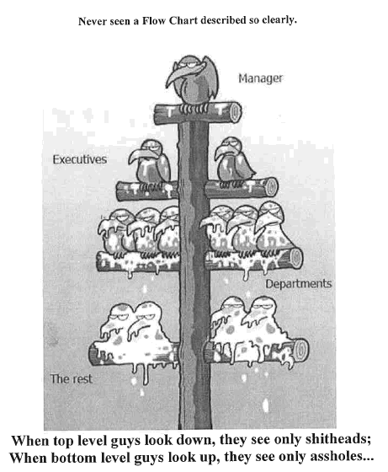

Slide 19
Four Ways of Knowing
Text
Verbal
Tables
Graphs

Slide 20
Have fun with your presentation!
But keep it professional

